Slide 1



Idiomatic Programmer Learning Keras
Computer Vision Workshop Version: July 2019

Slide 2
Idiomatic Programmer Learning Keras
Repo: github.com/GoogleCloudPlatform/keras-idiomatic-programmer
Workshops, Handbooks, and Model Zoo

Slide 3
Computer Vision Workshop - 2019
Session 1 : Models
Session 2 : Data Engineering
Session 3 : Training & Deployment

Slide 4
Computer Vision - Models
Part 1 : Covered in Neural_Network Study Pack
Part 2 : Covered in Convolutional_Neural Network Study Pack
Part 3 : Covered in Wide_Convolutional_Neural_Networks
Part 4: Covered in Advanced_Convolutional_Neural_Networks
Part 5: Covered in Mobile_Networks

Slide 5
Computer Vision - Data Engineering
Part 6 : Covered in Data_Engineering
Part 7 : Covered in Data_Engineering
Part 8 : Covered in Data_Augmentation
Part 9 : Covered in Data_Augmentation

Slide 6
Computer Vision - Training & Deployment
Part 10 : Training Preparation & Hyperparameter Tuning
Part 11 : Training and Deployment
Part 12 : Pre-Built Models & Transfer Learning
Part 13: Production

Slide 7
Training Prep & Hyperparameter Tuning
Training Preparation & Hyperparameter Tuning
In this part, we will cover best practices for preparing for training and hyperparameter tuning for a computer vision (image recognition) model.
Let’s briefly revisit what a model is. Prior to machine learning, software developers designed and coded algorithms, incorporating their and others’ domain expertise for the problem the algorithm will solve. The algorithm was primarily based on human engineering, with some machine assistance. The types of algorithms humans design can be characterized as:
Having a low dimensional input space,
Discrete input space with finite state changes, and
A linear relationship between the output behaviors and the input space.

Slide 8
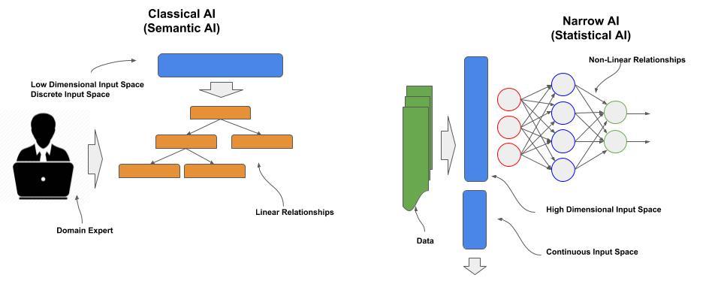
Training Prep & Hyperparameter Tuning
Model is an Algorithm discovered by Machine Learning
A model is an algorithm discovered by machine learning, which can be characterized as:
Having high dimensional input space,
A continuous input space, and
A non-linear relationship between the output behaviors and the input space.

Slide 9
Training Prep & Hyperparameter Tuning
High (vs. Low) Dimensionality
Humans are very good solving problems in low dimensional space. Low dimensionality is when there is just a few distinct inputs. For example, classifying an image as a polygon shape (e.g., triangle, rectangle, etc) using just two features: points and lines.
High dimensionality is when the number of inputs exceeds our ability to abstract how these inputs collectively contribute to a solution. As in our extremely simple problem above, once we go to a high number of features, it would be impossible for an engineer to reliably code a set of rules. Prior to deep learning, this is what engineers did and we referred to these as expert systems (aka business intelligence). But they were costly to build, constantly needed updating/tuning, and generally only achieved at most 70% reliability.

Slide 10
Training Prep & Hyperparameter Tuning
Continuous (vs. Discrete) Input Space
Humans are very good at solving problems when the input space is discrete. A discrete input space is when we have a fixed number of features, such as was described in our polygon recognition problem. A continuous input space is when the input space does not consist of a fixed number of features, but an unbounded set. In other words, when we cannot predetermine the features.
Let’s take fruit for an example, you probably could come up with an exhaustive list of types of fruits and their varieties, their shapes, textures and colors. But this is actually a continuous input space. Let’s just simply start with the fact that growers continuously breed (engineer) new varieties, which you could not anticipate. Let’s consider all the environmental conditions that the image may appear in, a kitchen, a garden, a commercial field, a warehouse, a grocery store, a kid’s school lunch --at some point, you could not anticipate all the environments. Let’s consider all the conditions of the fruit that may appear in the image, flowering stage, ripening stage, sliced, prepared, rottening, insect damaged, diseased, partially eaten --at some point, you could not anticipate all the conditions.

Slide 11
Training Prep & Hyperparameter Tuning
Continuous (vs. Discrete) Input Space
Humans are very good at solving problems when the input space is discrete. A discrete input space is when we have a fixed number of features, such as was described in our polygon recognition problem. A continuous input space is when the input space does not consist of a fixed number of features, but an unbounded set. In other words, when we cannot predetermine the features.
Let’s take fruit for an example, you probably could come up with an exhaustive list of types of fruits and their varieties, their shapes, textures and colors. But this is actually a continuous input space. Let’s just simply start with the fact that growers continuously breed (engineer) new varieties, which you could not anticipate. Let’s consider all the environmental conditions that the image may appear in, a kitchen, a garden, a commercial field, a warehouse, a grocery store, a kid’s school lunch --at some point, you could not anticipate all the environments. Let’s consider all the conditions of the fruit that may appear in the image, flowering stage, ripening stage, sliced, prepared, rottening, insect damaged, diseased, partially eaten --at some point, you could not anticipate all the conditions.

Slide 12
Training Prep & Hyperparameter Tuning
Non-Linearity
Most algorithms before machine learning, solved problems that either were all or very close to having some form of a linear relationship between the inputs and outputs. Classical use of linear and logistic regression, and decision trees were used on problems that had low dimensionality in the input space and high level of linearity, where the linearity could be expressed as a polynomial equation.
Algorithms which have high non-linearity cannot be expressed as a polynomial equation. Instead, the algorithm needs to be decomposed into segments of linearity and then combined through activation functions. With large datasets and increase in computing power, deep learning methods can be used to train a model to learn this decomposition and relationships (activations) between within the decomposition, which are typically represented as filters, weights and biases.

Slide 13
Training Preparation
Training Steps
When training a model, the following steps are typically followed:
Split the dataset into training, eval (validation) and test.
Repeat
Set hyperparameters like batch size and learning rate.
Repeat:
Shuffle the training data.
Feed the training data through the neural network (epoch).
Measure accuracy of the model on the train and eval data per epoch.
Monitor for convergence.
If targets for rate of convergence and accuracy are sufficient, stop training.
Measure final accuracy with the test data.

Slide 14
Training Preparation - Splitting
Splitting the Dataset
Prior to training the model, the [preprocessed] dataset needs to be split into training and test data, where a larger portion of the dataset will be used only for training, and a smaller portion only for testing. The later, test, is sometimes referred to as the holdout set.
In some cases, a portion of the training data is further split off into an eval data, which is sometimes referred to as validation data.
When the training data is large, typically a prior split is made for the eval data. The same eval data is then used at the end of each epoch to estimate what the accuracy will be on the test data; thus the eval data is never used as part of the training.
When the training data is small, a different random portion of the training data is used for validation per epoch, which is referred to cross-validation or rotation-estimation. In this case, eval data is used during training, but not on the specific epoch that it is used to estimate the accuracy on the test data.

Slide 15
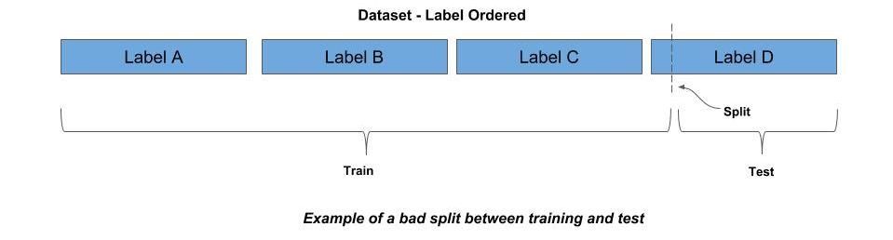
Training Preparation - Shuffling
Shuffling
When a dataset is split, both the training and test data should have the same probability distribution of the labels (classes). For example, if 10% of the data is of label A, then both the training and test data should contain 10% of label A.
A common mistake is to make an arbitrary split of the dataset. It’s not uncommon for datasets to be sequentially ordered by labels. For example, consider a dataset where all the data for label A comes first, then followed by label B, then label C, and so forth. If you made an arbitrary split, say the first 80% of the data is training and the last 20% is test, the training and test will not have the same probability distribution. Worse yet, it’s possible that some labels in the test won’t appear in the train (not learned) and some labels in train won’t appear in test (not verified).

Slide 16
Training Preparation - Stratification
Stratification
The common practice is to randomly shuffle the dataset prior to splitting. If the dataset is sufficiently large, a random shuffle should produce a probability distribution of the labels that is the same in the training and test data.
When the dataset is too small to maintain an equal probability distribution between train and test with a random shuffle, it is a common practice to stratify the data prior to randomly shuffling.
In this case, the data is partitioned into bins by label (stratify), and then random selections are made from the bin according to the probability distribution for the training data. The remaining unselected data becomes the test data.

Slide 17
Training Preparation - CSV File
Random Shuffling from a CSV File Listing
If your processed image data is in a file listing, like a CSV or JSON format, you can make an indirect index in memory to the file listing, and then randomly shuffle the in-memory index. The code below demonstrates using an indirect index to randomly shuffle the dataset as a file listing in a CSV file.
import random # open the CSV file and count (using sum) the number of lines, which equals the # number of samples with open(csv_file) as f: nimages = sum(1 for line in f) # subtract one from the total count if the first line in CSV file is a header if header: nimages -= 1 # create a sequential index between 0 and nimages-1 index = [i for i in range(nimages)] # now randomly sort the index random.shuffle(index)

Slide 18
Training Preparation - JSON File
Random Shuffling from a JSON File Listing
The code below demonstrates using an indirect index to randomly shuffle the dataset as a file listing in a JSON file, where the files are a list ([]) of objects, and each object has the key ‘image’.
dataset = json.load(json_file) nimages = dataset['image'] # create a sequential index between 0 and nimages-1 index = [i for i in range(nimages)] # now randomly sort the index random.shuffle(index)

Slide 19
Training Preparation - Keras
Keras ImageDataGenerator
In Keras, an image dataset can be shuffled and split into training and eval (validation) with the ImageDataGenerator class. This class is used to ingest a dataset for feeding a neural network during training. In the code example below:
The variable model refers to a Keras model that has already been compiled.
x_train and y_train refers to a processed dataset for training (i.e., already split), where x_train typically is a numpy array, with each element a preprocessed image, and y_train typically is a numpy array, with each element the corresponding one-hot encoded label.
The variable datagen is a generator, which is instantiated by ImageDataGenerator for feeding the neural network.
The method flow() sequential moves through the training data (x_train, y_train) in a specified batch size, which is specified as 32 in this example.
The parameter shuffle is set to True, which causes the training data to be shuffled by the generator, at the beginning of each epoch.
Each batch of training data is fed through the neural network using the model’s fit() method.

Slide 20
Training Preparation - Keras
Keras ImageDataGenerator
from keras.preprocessing.image import ImageDataGenerator # x_train and y_train assume the image data and labels have prior preprocessed and # split into training and test data. # instantiate an Image Data generator object datagen = ImageDataGenerator() # the number of batches in an epoch nbatches = len(x_train) // 32 # the number of epochs (training passes over the entire training data) epochs = 10 for epoch in range(epochs): batches = 0 # Use generator to create batches for x_batch, y_batch in datagen.flow(x_train, y_train, batch_size=32, shuffle=True): model.fit(x_batch, y_batch) batches += 1 if batches > nbatches: break

Slide 21
Training Preparation - Keras
Keras ImageDataGenerator - Rescale
In the code below, unlike the previous, the x_train data has not been normalized/standardized. In this case, the parameter rescale is passed to the instantiation of ImageDataGenerator, which will result in the corresponding flow() method normalizing the pixel data (i.e., dividing by 255) while the data is being fed:
from keras.preprocessing.image import ImageDataGenerator # x_train and y_train assume the image data and labels have been resized for the # CNN and split into training and test data, but the data has not been normalized. # instantiate an Image Data generator object and specify normalizing the image data datagen = ImageDataGenerator(rescale=1./255) # feed (train) the neural network

Slide 22
Training Preparation - Keras
Keras ImageDataGenerator - Standardization
In the code below, the rescale parameter is replaced with featurewise_std_normalization, which will standardize the data. Since standardization requires calculating the mean and standard deviation of the pixel data across the entire training set, a call is made the fit() method for the corresponding calculation.
from keras.preprocessing.image import ImageDataGenerator # instantiate an Image Data generator object and specify standardizing the image data datagen = ImageDataGenerator(featurewise_std_normalization=True) # calculate the mean/stddev for standardization datagen.fit(x_train) # feed (train) the neural network

Slide 23
Training Preparation - Keras
Keras ImageDataGenerator - Validation Split
In the code below, the parameter validation_split is added to use 10% of the training data as validation data on each epoch. Additionally, we do a single call for training per epoch (vs. manually batch feeding it), by passing the datagen.flow() generator to the fit_generator():
from keras.preprocessing.image import ImageDataGenerator x_train and y_train assume the image data and labels have been resized for the # CNN and split into training and test data, but the data has not been normalized. # instantiate an Image Data generator object datagen = ImageDataGenerator(rescale=1./255, validation_split=0.1) # the number of epochs (training passes over the entire training data) epochs = 10 for epoch in range(epochs): # Use generator to create batches model.fit_generator(datagen.flow(x_data, y_data, batch_size=32, shuffle=True))

Slide 24
Hyperparameter Tuning
Hyperparameters vs Learned Parameters
Let’s start by explaining the difference between learned parameters and hyperparameters. The learned parameters, are parameters that are learned during training. For neural networks, these typically are the weights on each neural network connection, the biases on each node, and for convolutional neural networks, the filters in each convolutional layer. These learned parameters stay as part of the model when the model is done training.
Hyperparameters are parameters used to train the model, but not part of the trained model itself. That is, once trained the hyperparameters no longer exist. Hyperparameters are used to improve the training of the model, such as for:
How long does it take to train the model?
How fast does the model converge?
Does it find the global optima?
How accurate is the model?
How overfitted is the model?
Another perspective of hyperparameters is that they are a means to measure cost and quality of developing the model.

Slide 25
Hyperparameter Tuning - Epochs
Epochs
The most basic hyperparameter is the number of epochs --though this is now being more commonly replaced with steps. The epochs hyperparameter is the number of times you will pass the entire training data through the neural network during training. Training is very expensive in compute time. It includes both the forward feed to pass the training data through and the backward propagation to update (train) the model’s parameters. For example, if a full pass of the data (epoch) takes 15 minutes and we run 100 epochs, the training time will take 25 hrs.

Slide 26
Hyperparameter Tuning - Epochs
Overtraining
Early presumptions on training was that the more times your feed the training data, the better the accuracy. What we’ve found, particularly on larger and more complex networks that there is a point where the accuracy will degrade. Today, we now look for convergence on an acceptable local optima for the purpose of how the model will be used in an application. If we overtrain the neural network, the following can happen:
The neural network becomes overfitted to the training data, showing increasing accuracy on the training data, but degrading accuracy on the test data.
In deeper neural networks, the layers will learn in a non-uniform manner and have different convergence rates. Thus, as some layers are working to convergences, others may have convergence and start diverging.
Continued training may cause the neural network to pop out of one local optima and start converging on another local optima, that is less accurate.

Slide 27
Hyperparameter Tuning - Epochs
Overtraining
Let’s start with a simple convnet model in Keras using the CIFAR-10 dataset to demonstrate the concept of convergence and then diverging. In the model, we have intentionally left out methods which prevent overfitting, like dropout or batch normalization.
from keras.datasets import cifar10 # load the Keras builtin CIFAR-10 dataset (x_train, y_train), (x_test, y_test) = cifar10.load_data() # … deleted for brevity # Train the model epochs=20 batch_size=32 model.fit(x_train, y_train, batch_size=batch_size, epochs=epochs, verbose=1, validation_data=(x_test, y_test))

Slide 28
Hyperparameter Tuning - Epochs
Overtraining
Below are the stats for the first six epochs. You can see with each pass there is a steady reduction in loss, which means the neural network is getting closer to fitting the data. Additionally, the accuracy on the training data is going up from 48.75% to 88.3% and on the validation data from 61.26% to 69.23%.
Train on 50000 samples, validate on 10000 samples Epoch 1/20 50000/50000 [==============================] - 61s 1ms/step - loss: 1.4311 - acc: 0.4875 - val_loss: 1.1157 - val_acc: 0.6126 Epoch 2/20 50000/50000 [==============================] - 59s 1ms/step - loss: 0.9873 - acc: 0.6536 - val_loss: 1.1588 - val_acc: 0.5883 Epoch 3/20 50000/50000 [==============================] - 59s 1ms/step - loss: 0.8072 - acc: 0.7197 - val_loss: 1.0325 - val_acc: 0.6475 Epoch 4/20 50000/50000 [==============================] - 59s 1ms/step - loss: 0.6512 - acc: 0.7736 - val_loss: 1.0646 - val_acc: 0.6469 Epoch 5/20 50000/50000 [==============================] - 58s 1ms/step - loss: 0.4972 - acc: 0.8293 - val_loss: 0.9752 - val_acc: 0.6908 Epoch 6/20 50000/50000 [==============================] - 58s 1ms/step - loss: 0.3479 - acc: 0.8830 - val_loss: 1.0822 - val_acc: 0.6923

Slide 29
Hyperparameter Tuning - Epochs
Overtraining
Let’s now look at epochs 11 thru 20. You can see that we’ve hit a 100% on the training data, which means we are tightly fitted to the training data. On the other hand, our accuracy on the validation data plateaued at 69.96%. Thus, after six epochs, there was no improvement from continued training, and we can conclude that by epoch 7 the model was overfitted to the training data.
Epoch 11/20 50000/50000 [==============================] - 58s 1ms/step - loss: 0.0198 - acc: 0.9944 - val_loss: 2.0663 - val_acc: 0.6915 Epoch 12/20 50000/50000 [==============================] - 59s 1ms/step - loss: 0.0112 - acc: 0.9970 - val_loss: 2.1746 - val_acc: 0.6939 # … deleted for brevity Epoch 18/20 50000/50000 [==============================] - 59s 1ms/step - loss: 8.6766e-05 - acc: 1.0000 - val_loss: 2.6870 - val_acc: 0.6994 Epoch 19/20 50000/50000 [==============================] - 58s 1ms/step - loss: 2.3760e-05 - acc: 1.0000 - val_loss: 2.7450 - val_acc: 0.6991 Epoch 20/20 50000/50000 [==============================] - 59s 1ms/step - loss: 1.5005e-05 - acc: 1.0000 - val_loss: 2.7683 - val_acc: 0.6996

Slide 30
Hyperparameter Tuning - Steps
Steps
Over the course of the last few years, a lot of insights have been learned by researchers and practitioners on how neural networks learn. These insights have lead to focusing on regularization, normalization, augmentation, and sampling distributions. In shorter words, we can improve accuracy and reduce training time by changing the sampling distribution of the training dataset.
In epochs, we think of a sequential draw of batches from our training data. Even though we randomly shuffle the training data at the start of each epoch, the sampling distribution is still the same.

Slide 31
Hyperparameter Tuning - Steps
Learning the Best Sampling Distribution
Let’s now think of the entire population of what we want to recognize. In statistics, we call this the population distribution.
But we will never have a dataset that is the actual entire population distribution. Instead, we have some sample, which we refer to as a sampling distribution of the population distribution.
Another way to improve our model, is to additionally learn the best sampling distribution to train the model with. While our dataset maybe fixed, we can do a number of methods to alter the distribution, and thus learn the sampling distribution that best fits training the model. These methods include:
Regularization / Dropout
Batch Normalization
Data Augmentation

Slide 32
Hyperparameter Tuning - Steps
Learning the Best Sampling Distribution
We no longer see feeding the neural network as sequential passes over the training data, but as making random draws from a sampling distribution. In this context, steps refers to the number of batches (draws) we will make from the sampling distribution of our training data.
When we add dropout layers to the neural networks, we are randomly dropping activations on a per sample basis. In addition to reducing overfitting of a neural network, we are also changing the distribution.
With batch normalization, we are minimizing covariance shift between our batches of training data (samples). Like using standardization on our input, the activations are rescaled using standardization (i.e., subtract the batch mean and divide by the batch standard deviation). This normalization reduces the fluctuations in updates to parameters in the model --referred to as adding more stability to the training. In addition, this normalization mimics drawing from a sampling distribution that is more representative of the population distribution.

Slide 33
Hyperparameter Tuning - Steps
Learning the Best Sampling Distribution
With data augmentation, we create new samples by modifying existing samples within a set of parameters, from which we randomly select the modification, which also contributes to changing the distribution.
With batch normalization, regularization/dropout and data augmentation, no two epochs will have the same sampling distribution. In this case, the practice now is to limit the number of random draws from each new sampling distribution, which is referred to as steps. For example, if steps is set to 1000, then per epoch, only a 1000 random batches will be selected and feed into the neural network for training.
In Keras, we can specify both the number of epochs and steps as parameters to the fit() or fit_generator() methods:
model.fit(x_train, y_train, batch_size=32, epochs=10, steps_per_epoch=1000)

Slide 34
Hyperparameter Tuning - Batch Size
Batch Size
To understand how to set batch size, you should have a basic understanding of the three types of gradient descent algorithms; wherein the gradient descent algorithm is the means by which the model parameters are updated (learned) during training.
Stochastic Gradient Descent
Batch Gradient Descent
Mini-Batch Gradient Descent (conventional method today)

Slide 35
Hyperparameter Tuning - Batch Size
Batch Size - Stochastic Gradient Descent
In stochastic gradient descent (SGD), the model is updated after each sample is fed through during training. Since each sample is randomly selected, the variance between samples can result in large swings in the gradient.
A benefit to this:
During training one is less likely to converge on a local optima, and more likely to find the global optima to converge on.
Another benefit is that the rate of change in loss can be monitored in real-time, which may aid in algorithms that do auto-hyperparameter tuning.
The downside is that this is more computationally expensive per epoch.

Slide 36
Hyperparameter Tuning - Batch Size
Batch Size - Batch Gradient Descent
In batch gradient descent, the error loss per sample is calculated as each sample is fed through during training, but the updating of the model is done at the end of each epoch (i.e., after the entire training data is passed through). As a result, the gradient is smoothed out since its calculated across the loss of all the samples, instead of a single sample.
A benefit to this:
Is less computational expensive per epoch, and the training more reliably converges.
The downside is that the model may converge on a less accurate local optima, and an entire epoch needs to be ran to monitor performance data, thus less likely to be used by algorithms that do auto-hyperparameter tuning.

Slide 37
Hyperparameter Tuning - Batch Size
Batch Size - Mini-Batch Gradient Descent
The mini-batch gradient descent method is a tradeoff between stochastic and batch gradient descent. Instead of one sample or all samples, the neural network is fed in mini-batches which are a subset of the entire training data.
The smaller the mini-batch side, the more the training will resemble stochastic gradient descent, while larger batch sizes will resemble batch gradient descent.
For certain models and datasets, stochastic gradient descent (SGD) works best. In general, it’s a common practice to use the trade-off of mini-batch gradient descent. The hyperparameter batch_size is the size of the mini-batch. Due to hardware architectures, the most time/space efficient batch sizes are multiples of 8, such as 8, 16, 32 and 64. The batch_size that is most commonly tried first is 32. One generally never sees a batch size greater than 128.

Slide 38
Hyperparameter Tuning - Batch Size
Mini-Batch Size in Keras
In Keras, you can specify the batch_size either in the model fit()/fit_generator() methods:
Alternately, if using the ImageDataGenerator, batch_size can be specified in the corresponding flow()/flow_from_directory()/flow_from_dataframe() methods:
# model is a compiled keras model (Model or Sequential class). model.fit(x_train, y_train, batch_size=32)
# randomly rotate images +/- 20 degrees datagen = ImageDataGenerator(rotation_range=20) # train the model model.fit_generator(datagen.flow(x_train, y_train, batch_size=32), epochs=10)

Slide 39
Hyperparameter Tuning - Learning Rate
Learning Rate
The learning rate is generally the most influential of the hyperparameters. It can have a significant impact on:
The length of time to train a neural network.
Whether the neural network converges on a local optima.
Whether it converges on the best (global) local optima.
When doing updates to the model parameters during the backward propagation pass, the gradient descent algorithm is used to derive a value to add/subtract to the parameters in the model from the loss function for that pass.
These additions and subtractions could result in large swings in parameter values. If a model has and continues to have large swings in parameter values, the model will be ‘all over the map’ and never converge.

Slide 40
Hyperparameter Tuning - Convergence
Convergence
What is convergence? This is when there is a steady reduction in the loss (referred to as minimizing the loss) and a steady increase or plateau in the accuracy per pass. If you observe big swings in the amount of loss and/or accuracy, then the training of your model is not converging.
If the training is not converging, it won’t matter how many epochs you run, it will never finish training.
The learning rate provides us with a means to control the degree that the model parameters are updated. In the basic method, the learning rate is a fixed coefficient between 0 and 1 that is multiplied against the value to add/subtract, to reduce the amount being added or subtracted. These smaller increments add more stability during the training and increase the likelihood of convergence.

Slide 41
Hyperparameter Tuning - Learning Rate
Small vs. Large Learning Rate
If we use a very small learning rate, like 0.001, we will eliminate large swings in the model parameters during updates. This will generally guarantee that the training will converge on a local optima.
But there is a drawback. First, the smaller we make the increments, the more passes of the training data (epochs) will be needed to minimize the loss. That means more time to train.
Second, the smaller the increments the less likely the training will explore other local optimas, which might be more accurate than the one that the training is converging on; instead, it may converge on poor local optima or get stuck on a saddle point.

Slide 42
Hyperparameter Tuning - Learning Rate
Small vs. Large Learning Rate
A large learning rate, like 0.1, likely will cause big jumps in the model parameters during updates. In some cases, it might initially lead to faster convergence (less epochs).
The drawback is that even if you are initially converging fast, the jumps may overshoot and start causing the convergence to swing back and forth, or hops across different local optima. At very high learning rates, the training may start to diverge (i.e., increasing loss).
There are a lot of factors of what will be the best learning rate at different times during the training. In best practices the rate will range between 0.1 and 10e-5.
Below is a basic formula of how a weight is adjusted by multiplying the learning rate by the amount calculated to add/subtract (gradient):
weight += -learning_rate * gradient

Slide 43
Hyperparameter Tuning - Learning Rate
Decay
A common practice has been to start with a slightly larger learning rate, and then gradually decay the learning rate. The larger learning rate would at first explore different local optima to converge on and make some initial deep swings into the respective local optimas.
The rate of convergence and minimizing the loss function on the initial updates can be used to hone in on the best (good) local optima. From that point, then the learning rate is gradually decayed. As the learning rate decays, swings out of the good local optima are prevented and the steadily decreasing learning rate will tune the convergence to approach the minimal point.
albeit, the smaller and smaller learning rate will increase training time.
Below is a basic formula of how decay is added to the calculation of updating the weights, where on each update, the learning rate is reduced by the decay amount.
weight += -learning_rate * gradient learning_rate -= decay

Slide 44
Hyperparameter Tuning - Learning Rate
Momentum
Another practice is to accelerate or decelerate the rate of change based on prior changes. If we have large jumps in convergence, we risk jumping out of the local optima, so we may want to decelerate the learning rate; while if we have small to no changes in convergence, we may want to accelerate the learning rate to hop over a saddle point. Typically values for momentum range from 0.5 to 0.99.
velocity = (momentum * velocity) - (learning_rate * gradient) weight += velocity

Slide 45
Hyperparameter Tuning - Optimizers
Optimizers
For Keras, these learning rate algorithms are specified when the optimizer is defined for minimizing the loss function.
from keras import optimizers # instantiate an optimizer optimizer = optimizers.RMSprop(lr=0.001, rho=0.9, epsilon=None, decay=0.0) # compile the model, specifying the loss function and optimizer model.compile(loss='mean_squared_error', optimizer=optimizer)

Slide 46
Hyperparameter Tuning - Feeding
Training Feeders
To train a neural network, the training data is fed through the neural network in a forward pass either as individual samples (stochastic), batches (mini-batch) or an epoch (batch) at a time, followed by a backward propagation pass to update the parameters of the model.
This process is referred to as feeding the neural network, and the mechanisms for feeding the neural network are called feeders.

Slide 47
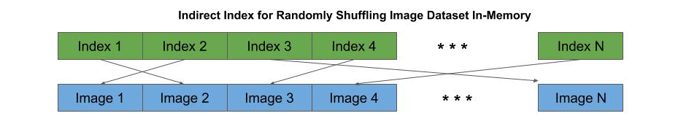
Feeders - In-Memory
In-Memory Feeder
The most efficient (fastest) way to feed a neural network for training is to use an in-memory feeder. Typically, the preprocessed image data is stored as a contiguous region of memory. The feeder uses an indirect index to each preprocessed image in memory, by which the feeder can randomly shuffle, draw batches, and do transforms without moving memory.
batch_size = 32 # the mini-batch size epochs=10 # the number of epochs # once the model is compiled and the image data has been preprocessed, # the fit method will start training the model, where x_train and y_train # are the preprocessed image data and one-hot encoded labels model.fit(x_train, y_train, batch_size=batch_size, epochs=epochs)

Slide 48
Feeders - In-Memory
In-Memory Generator Feeder
The fit_generator() method is similar to the fit() method, but uses a generator, which is constructed with the ImageDataGenerator class. This generator enables image augmentation, where augmented images are generated on-the-fly as the neural network is being fed. The flow() method of the data generator then constructs mini-batches which consist of a combination of the original images and augmented versions.
# randomly rotate images +/- 20 degrees datagen = ImageDataGenerator(rotation_range=20) # train the model using the flow() method of the generator to create mini-batches model.fit_generator(datagen.flow(x_train, y_train, batch_size=32), epochs=10)

Slide 49
Feeders - On-Disk
On-Disk Generator Feeder
If your memory resources are not sufficient to hold the entire preprocessed dataset in memory, then you will need to continuously feed the neural network by drawing batches from the on-disk storage of the preprocessed (or original) image data.
The drawback is that for each mini-batch, the generator must re-read the preprocessed (or original) data from the disk.
In the code below, we first create a generator using the ImageDataGenerator class, which we will use in conjunction with the flow_from_directory() method.
# normalize the pixel data (rescale) as its read from memory, and # randomly rotate images +/- 20 degrees datagen = ImageDataGenerator(rescale=1/255., rotation_range=20) # train the model using the flow_from_directory() method model.fit_generator(datagen.flow_from_directory('dataset', target_size=(128,128), batch_size=32), epochs=10)

Slide 50
Feeders - Hybrid
Hybrid: Mix In-Memory and On-disk
Continuously re-reading each image from on-disk is the least efficient method to feed the neural network for training.
One can consider using a hybrid approach. What we do in a hybrid feeding is:
Take a large segment of the preprocessed data (8BG for example) at a time, which has been stratified.
Repeatedly feed the same segment to the neural network as epochs.
Each time, we do image augmentation such that each epoch is a unique sampling distribution of the entire preprocessed image dataset.

Slide 51
Feeders - Hybrid
Hybrid: Mix In-Memory and On-disk
Below is a description of the steps to do a hybrid in-memory/on-disk feeding:
Create a stratified index to the preprocessed image data on disk.
Partition the stratified index into partitions based on the available memory to hold a segment in memory.
For each segment:
Repeat for a specified number of epochs
Randomly shuffle the segment per epoch.
Randomly apply image augmentation to create a unique sampling distribution per epoch.
Feed the mini-batches to the neural network.

Slide 52
Test Data
Test Data
The test data, also known as the hold-out set, is the portion of the dataset that was not used in training. These are samples that the model never saw during training. Once the model has been trained with the training data, a forward pass is made through the trained model (referred to as evaluation) to predict the likely accuracy the model will have when deployed and predicting (inference) on samples it has not seen before.
Generally, the accuracy of the test data is slightly less than that of the training data.
If though there is a large difference between the training accuracy (high) and the test accuracy (low), then the model is overfitted to the training data.
In Keras, once the model has been trained, we use the evaluate() method to obtain the accuracy on the test data.
# Evaluate the model using the test (hold-out) data score = model.evaluate(x_test, y_test) print("Test Accuracy", score[1])

Slide 53
Training and Deployment
Training Cycle
Let’s start by discussing the training cycle, before we do a deep dive. The general phases of training are:
Pretraining - find best hyperparameters for training. Repeat:
Set initial hyperparameters.
Run a partial training session.
Examine rate of changes in accuracy and loss on training and validation data.
If acceptable, stop pre-training phase.
Set training objectives:
for accuracy on validation data.
rate of progression in reducing loss on training data.
Plan number of epochs or steps to meet objectives.
Training:
Start full training.
If objective meet, early stop and checkpoint model
If diverging from objectives, terminate training

Slide 54
Pretraining
Pretraining
The purpose of the pretraining phase is to find the best hyperparameter settings to initiate a full training run. Let’s revisit what goes wrong when the wrong hyperparameters are used during training:
It takes an excessive time to train the model.
The model gets stuck on a saddle point and never converges.
The model becomes overfitted and diverges.

Slide 55
Weights Initialization
Weights/Biases Initialization
When training starts, all the weights and biases need an initial value. Those initial values can impact how long and how accurate the model will be, even when everything else is right.
If we initialize the weights to zero, then all the updates to the weights in the neural network during training will be the same --i.e., the neurons will be symmetric. As a result, the network is the same as a single neuron.
For biases, this is not the case, and the current practice is to initialize them to zero.

Slide 56
Weights Initialization
Uniform Random Distribution
For the weights, they are initialized by some random distributions. A uniform random distribution will generate produce a good result. But practices have shown that a uniform distribution can result in significant variance in the final accuracy.
In the past, using a uniform random distributions, several instances of the model would be trained in parallel with different uniform random distributions.
In 2010, a paper by Xavier Glorot demonstrated that drawing a random distribution from a Gaussian distribution with a mean of zero resulted more consistently in obtaining the best accuracy. The specific distribution, known now as Xavier initialization, works best when the activation function for hidden units is a tanh.
In 2015, a variant of Xavier known as He, was found to work best when the activation function for the hidden units was a ReLU or Leaky ReLU.

Slide 57
Weights Initialization
He-Normal Initialization
Keras supports a large variety of random initializers. By default, the weights are initialized by a uniform random distribution and the biases are set to zero. Since CNN use ReLU and Leaky ReLU activations for the convolutional and dense layers, the best practice today is to initialize the weights using the He initialization.
from keras import initializers # initialize the weights using He initialization when activation function is ReLU model.add(Dense(128, kernel_initializer='he_normal')) model.add(ReLU())

Slide 58
Initial Learning Rate
Learning Rate Initialization
The learning rate is considered to have the most impact on training your model and the most uncertainty of what the initial rate should be. It is highly dependent on the type of image data and the distribution of images (samples) in the dataset.
The best practice is that the initial learning rate will be between 0.1 and 10e-5.
But how do you pick the number? Does one just guess and try and try again? Sort of. We do grid search. One will train several instances of the model for short number of epochs at different learning rates and look at the rate of change in the loss and accuracy of the validation data.
Generally, a grid search is used on a set of learning rates, where the set is typically a logarithmic scale between 0.1 and 10e-5, such as: [ 0.1, 0.01, 0.001, 0.0001, 0.00001 ]

Slide 59
Learning Rate (Grid) Search
Learning Rate (Grid) Search
What you’re trying to achieve here is to find the highest initial learning rate that:
Makes the fastest route to convergence on initial training start,
Prevents the training from being stuck on a saddle point, but:
Not so large, that it either:
Bounces around different local optima, or
Dives into a poor local optima.
On the other hand, one does not want to pick an initial learning rate on the lowest end, that:
Increases training time to converge,
Gets stuck or a saddle point, or
Does not explore for better local optimas.

Slide 60
Learning Rate / Gradient Descent
Learning Rate and Gradient Descent
The concept of gradient descent is a measurement of the slope of the rate of change.
If we have a function, say f(x) where the relationships between the input and the outputs is linear, we would expect the slope to be a straight line. In this case:
The learning rate would only affect how long it would take to find the global optima, but since there is only one optima, we would find it nonetheless.
On the other hand, if f(x) is a polynomial function, we expect the slope to look more like a curved bowl. Now the learning rate would affect whether we find the global optima.
That is, to high of a rate and we bounce around the curved bowl. A tiny learning rate, and we are (almost) guaranteed to descent eventually to the global optima, but it may take a long time.

Slide 61
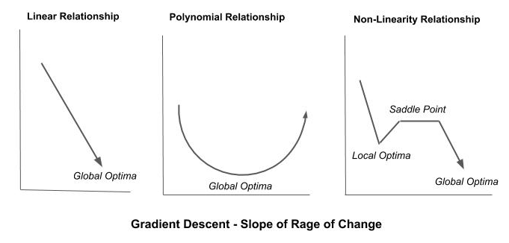
Learning Rate / Gradient Descent
Learning Rate and Gradient Descent
In the simplified third example depicted below, the function f(x) is comprised of segments of non-linearity. In addition to a global optima, we depict a local optima which the training could dive into and converge on, overlooking the global optima. Likewise is a saddle point. This is a plateaued region of the slope. If our learning rate is too small, one might bounce back and forth on the plateau and never escape.

Slide 62
Learning Rate / Optimizer
Optimizer
In Keras, optimizers can be specified in two ways.
As a string value to the parameter optimizer in the compile() method. In this case, the selected optimizer is configured with default settings.
An optimizer can also be specified from the optimizer class, and configured when the optimizer object is instantiated. In this case, the selected optimizer is configured with a learning rate of 0.01.
model.compile(optimizer='rmsprop', loss='categorical_crossentropy', metrics=['accuracy'])
from keras import optimizers optimizer = optimizers.RMSProp(lr=0.01) model.compile(optimizer=optimizer, loss='categorical_crossentropy', metrics=['accuracy'])

Slide 63
Checkpointing
Checkpointing
Checkpointing is periodically saving the learned model parameters and current hyperparameter values during training. There are two reasons for doing this:
To be able to resume training of a model without restarting the training (where it left off).
Identify a past point training that the model gave the best results.
In the former case (resume training), for resource management one may split the training across sessions. For example, one might reserve (or be authorized) one hour a day for training. At the end of the one hour training each day, the training is checkpointed. The following day, training is resume by restoring from the checkpoint.

Slide 64
Transfer Learning and Pre-built Models
Pre-Built Models
The Keras framework comes with a number of pre-built models, which you can use either as-is to train a new model, or modify and/or fine-tune for transfer learning. These models are based on best-in-class models for image classification, which have been award winning models in competitions like ImageNet.
The pre-built model architectures include:
Sequential CNN
VGG16, VGG19
Residual CNN
ResNet
Wide Layer CNN ResNeXt, Inception
Advanced CNN DenseNet, Xception, NASNet
Mobile
MobileNet

Slide 65
Transfer Learning and Pre-built Models
Importing Pre-Built Models
The pre-built Keras models are imported from the keras.applications module. Below are some examples:
from keras.applications import VGG16 from keras.applications import VGG19 from keras.applications import ResNet50 from keras.applications import InceptionV3 from keras.applications import InceptionResNetV2 from keras.applications import DenseNet121 from keras.applications import DenseNet169 from keras.applications import DenseNet201 from keras.applications import Xception from keras.applications import NASNetLarge from keras.applications import NASNetMobile from keras.applications import MobileNet

Slide 66
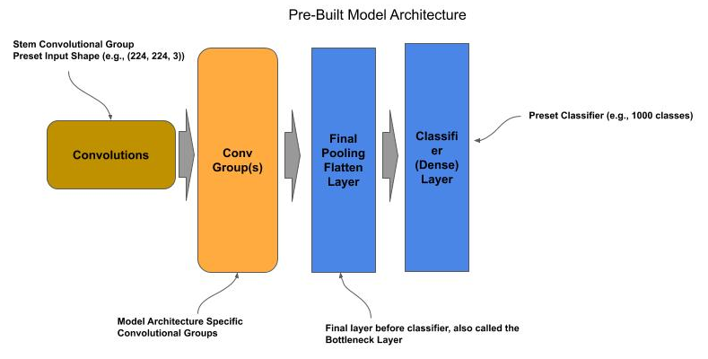
Pre-built Models
Base Model
By default, the pre-built models are complete but untrained (i.e., the weights and biases are randomly initialized). Each untrained pre-built model is configured for a specific input shape and number of output classes. In most cases the input shape is either (224, 224, 3) or (299, 299, 3). The models will also take input in channel first format as in (3, 224, 224) and (3, 299, 299). In most cases, the number of output classes is 1000.

Slide 67
Pre-built Models
Compiling the Base Model
The pre-built models do not have an assigned loss function and optimizer. Prior to using them, one must issue the compile() method to assign the loss, optimizer and performance measurements.
from keras.applications import ResNet50 # Get a pre-built ResNet50 model model = ResNet50() # Compile the model for training model.compile(loss='categorical_crossentropy', optimizer='adam', metrics=['accuracy']) # Now train the model

Slide 68
Pre-trained Models
Pre-trained Models
All of the pre-built models come with weights and biases pre-trained from ImageNet 2012 dataset; which is a dataset of 1.2 million images across 1000 classes. If your need is simply to predict if an image is within the 1000 classes of ImageNet dataset, then one can use the pre-trained pre-built models as-is.
from keras.applications import ResNet50 from keras.applications.resnet import preprocess_input, decode_predictions # Get a pre-built ResNet50 model model = ResNet50(weights='imagenet') # Read the image into memory as a numpy array image = cv2.imread('elephant.jpg', cv2.IMREAD_COLOR) # Resize the image to fit the input shape of ResNet model image = cv2.resize(image, (224, 224), cv2.INTER_LINEAR) # Preprocess the image using the same image processing used by the pre-built model image = preprocess_input(image) # Reshape from (224, 224, 3) to (1, 224, 224, 3) for the predict() method image = image.reshape((-1, 224, 224, 3)) # Call the predict() method to classify the image predictions = model.predict(image) # Display the class name based on the predicted label using the decode function for # the built-in model. print(decode_predictions(preds, top=3))

Slide 69
Pre-trained Models
New Classifier
The final classifier layer in all the pre-built models can be removed and replaced with a new classifier. The new classifier can then be used to train the pre-built model for a new dataset and set of classes.
The classifier layer is referred to as the top layer. When instantiating an instance of a pre-built model:
Set the parameter include_top to False to get an instance without the classifier.
When the include_top=False, one can also reset the input shape of the model with the parameter input_shape.

Slide 70
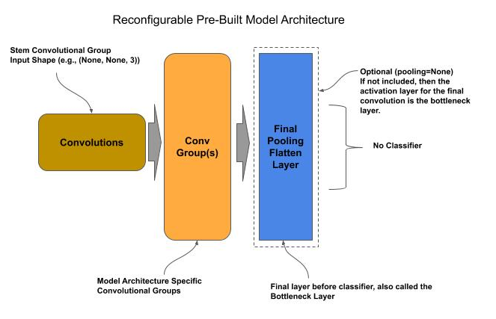
Pre-trained Models
Reconfiguring a Pre-Built Model

Slide 71
Pre-trained Models
Adding a New Classifier
In the code below, we instantiate a pre-built ResNet model and replace it with a new classifier for 20 classes:
from keras.applications import ResNet50 from keras.layers import Dense # Get a pre-built model for input shape (100,100,3) and without the classifier model = ResNet50(include_top=False, input_shape=(100, 100, 3), pooling='avg') # Add a classifier for 20 classes model.add(Dense(20, activation='softmax')) # Compile the model for training model.compile(loss='categorical_crossentropy', optimizer='adam', metrics=['accuracy']) # Now train the model

Slide 72
Pre-trained Models
Final Pooling Layer
For most models, the final layer preceding the classifier is a global average pooling layer. This layer acts as both a final pooling layer for the feature maps and a flatten operation (convert to 1D vector). One might want to replace this layer with one’s own custom final pooling/flatten layer. In this case, one either specifies the parameter pooling to None.
from keras.applications import ResNet50 from keras.layers import Dense, Flatten from keras import Model # Get a pre-built model for input shape (100,100,3) and without the classifier model = ResNet50(include_top=False, input_shape=(100, 100, 3), pooling=None) # Flatten the Feature Maps into a 1D vector output = Flatten()(model.output) # Add a classifier for 20 classes output = Dense(20, activation='softmax')(output) # Compile the model for training model = Model(model.input, output) model.compile(loss='categorical_crossentropy', optimizer='adam', metrics=['accuracy']) # Now train the model

Slide 73
Transfer Learning
Transfer Learning
Transfer learning is where one uses pretrained models for one task and retrain the classifier and/or fine-tune layers for a new task.
There are two general approaches to transfer learning:
Similar Tasks (Image Domains)
Distinct Tasks

Slide 74
Transfer Learning - Similar Tasks
Similar Tasks
When deciding on the approach, we look at the similarity of the source (pre-trained) domain of images and the destination (new) domain.
The more similar, the more of the existing bottom layers we can reuse without training.
For example, if one had a model trained on fruits, it’s probably that all of the bottom layers of the pretrained model can be reused (without retraining) for building a new model to recognize vegetables.

Slide 75
Transfer Learning - Similar Tasks
Similar Tasks
For similar tasks, we assume that:
The coarse features learned at the bottom-most layers will be the same for the new classifier,
The grouping of coarse features in the middle layers and final assembly into details all can be reused as-is, prior to entering the topmost layer(s) for classification.
When the source and destination domains have this high level of similarity, we generally can:
Replace the existing topmost classifier layer with a new classifier layer,
Freeze the lower layers and train only the classifier layer.
Since we don’t need to learn the weights/biases for the other layers, we can generally train a model for the new domain with substantially less data and fewer epochs.

Slide 76
Transfer Learning - Similar Tasks
Similar Tasks - Dataset Size
Transfer learning between similar source and destination domains provides the ability to train with substantially smaller datasets. The two most general best practices for the minimum size of the dataset are:
Each class (label) is 10% as big as in the source dataset.
Each class (label) has at least 100 images.

Slide 77
Transfer Learning - Similar Tasks
Similar Tasks - Freezing Layers
We modify the code to freeze all the layers preceding the topmost classifier layer prior to training. Freezing prevents the weights/biases of the layer(s) from being updated during training.
In Keras, each layer has the property freeze, which defaults to True.
Use a pre-built model with pre-trained weights/biases (ImageNet 2012),
Drop the existing classifier from the pre-built model (topmost layer).
Freeze the remaining layers.
Add a new classifier layer.
Train the model through transfer learning.

Slide 78
Transfer Learning - Similar Tasks
Retraining a ResNet-50 Model
from keras.applications import ResNet50 from keras.layers import Dense from keras import Model # Get a pre-trained/pre-built model without the classifier and retain the global # average pooling # layer following the final convolution (bottleneck) layer model = ResNet50(include_top=False, pooling='avg', weights='imagenet') # Freeze the weights of the remaining layer for layer in model.layers: layer.trainable = False # Add a classifier for 20 classes output = Dense(20, activation='softmax')(model.output) # Compile the model for training model = Model(model.input, output) model.compile(loss='categorical_crossentropy', optimizer='adam', metrics=['accuracy']) # Now train the model

Slide 79
Transfer Learning - Distinct Tasks
Distinct Tasks
When the source and destination domain of the image datasets are non-similar, one starts with the same steps as in the similar task approach above, but then follows up with fine-tuning the bottom layers. The steps in this approach generally are:
Add a new classifier layer and freeze the remaining layer.
Train the new classifier layer the target number of epochs.
Repeat for fine-tuning:
Unfreeze the next bottom-most convolutional group
(moving in direction of top to bottom)
Train for a few epochs to fine-tune.
Once the convolutional groups are fine-tuned:
Unfreeze the convolutional stem group
Train for a few epochs to fine-tune

Slide 80
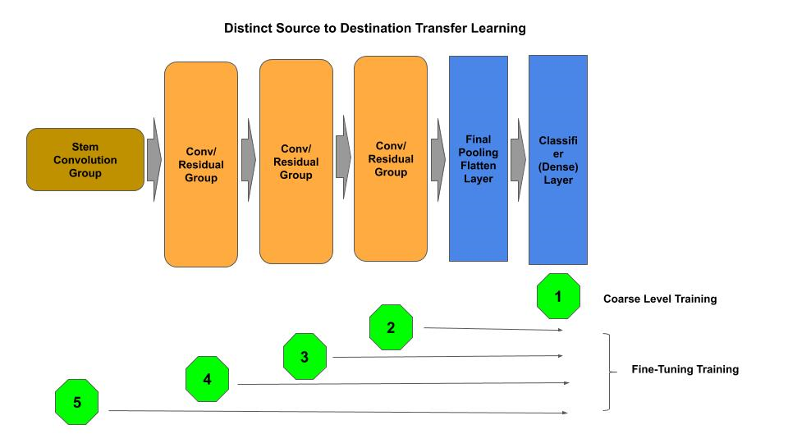
Transfer Learning - Distinct Tasks
Distinct Tasks - (Re)Training Overview

Slide 81
Transfer Learning - Distinct Tasks
Transfer Learning - Coarse Training
In the next code example, we start with a a coarse training for the add classifier level, followed by fine-tuning of each convolutional (residual) group and finally the stem convolutional group.
# Deleted for brevity ... # Freeze the weights of the remaining layer for layer in model.layers: layer.trainable = False # Add a classifier for 20 classes output = Dense(20, activation='softmax')(model.output) # Compile the model for training model = Model(model.input, output) model.compile(loss='categorical_crossentropy', optimizer='adam', metrics=['accuracy']) # Coarse Level Training of the classifier model.fit(x_data, y_data, batch_size=32, epochs=50, validation_split=0.2)

Slide 82
Transfer Learning - Distinct Tasks
Transfer Learning - Finer Training
Next we will do the fine-tuning of each convolutional (residual) group. The first step below, we scan through the model building a list of the residual groups, and convolutional layers within the group, in sequential order.
stem = None # layer that is the convolutional layer for the stem group groups = [] # the add layer for each convolutional group conv2d = [] # the convolutional layers of a group first_conv2d = True for layer in model.layers: if type(layer) == layers.convolutional.Conv2D: # In ResNet50, the first Conv2D is the stem convolutional layer if first_conv2d == True: stem = layer first_conv2d = False # Keep list of convolutional layers per convolutional group else: conv2d.append(layer) # Each convolutional group in Residual Networks ends with a Add layer. # Maintain list in reverse order (top-most conv group is top of list) elif type(layer) == layers.merge.Add: groups.insert(0, conv2d) conv2d = []

Slide 83
Transfer Learning - Distinct Tasks
Transfer Learning - Finer Training
Next, we fine-tune train each convolutional group, sequentially from the top-most group proceeding to the bottom-most, for a smaller number of epochs (5) than the coarse training. Finally, we fine-tune train the stem convolutional group.
# Unfreeze a convolutional group at a time (from top-most to bottom-most) # And fine-tune (train) that layer for i in range(1, len(groups)): # Unfreeze the convolutional layers in this conv/residual group for layer in groups[i]: layer.trainable = True # re-compile the model for training model.compile(loss='categorical_crossentropy', optimizer='adam', metrics=['accuracy']) # Fine-tune train the convolutional group(s) model.fit(x_data, y_data, batch_size=32, epochs=5) # Unfreeze the stem convolutional and do a final fine-tuning stem.trainable = True model.compile(loss='categorical_crossentropy', optimizer='adam', metrics=['accuracy']) model.fit(x_data, y_data, batch_size=32, epochs=5, validation_split=0.2)

Slide 84
Transfer Learning - Domain Training
Domain Specific Weights
One may desire to have pre-trained weights from a specific domain, other than the ImageNet 2012. In the next code example, we:
first train a ResNet50 pre-built architecture for a specific domain (e.g., produce),
and then subsequently use the pretrained domain specific weights and initialization to train another ResNet50 model in a similar domain.
Steps:
Instantiate an uninitialized ResNet50 model without the classifier and pooling layer, which we designate as the base model.
Save the base model architecture for later reuse in transfer learning (produce-model.json).
model = ResNet50(include_top=False, pooling=None, input_shape=(100, 100, 3)) # save the base model base_model = model.to_json()# Write the JSON string to a file with open('produce-model.json', 'w') as f: f.write(base_model)

Slide 85
Transfer Learning - Domain Training
Domain Specific Weights - Train for a Specific Domain
Next, we:
Add a classifier (Flatten and Dense layers) and train for a specific (source) domain (e.g., produce).
Save the weights for the trained model (produce-weights.h5)
# Add classifier output = Flatten(name='bottleneck')(model.output) output = Dense(20, activation='softmax')(output) # do training here # save the model weights model.save_weights('produce-weights.h5')

Slide 86
Transfer Learning - Domain Training
Domain Specific Weights - Transfer Train for New Domain
Finally, we:
Load the base model architecture (`model-produce.json), which does not contain the classifier layer.
Initialize the base model architecture with the pretrained weights for the source domain (model-produce.h5).
Add a classifier for the new similar domain.
Train the model/classifier for the new similar domain.
# Read the JSON string for the base model from a file with open('produce-model.json', 'r') as f: base_model = f.read() # Reuse the base model and trained weights model = model_from_json(base_model) model.load_weights('produce-weights.h5') # Add classifier output = Flatten(name='bottleneck')(model.output) output = Dense(20, activation='softmax')(output) # Compile the model model = Model(model.input, output) model.compile(loss='categorical_crossentropy', optimizer='adam', metrics=['accuracy']) # train the new model for a new dataset

Slide 87
Transfer Learning - Domain Initialization
Domain Transfer Weight Initialization
Another form of transfer learning, is transfer of domain specific weights to use as weight initialization in a model one will otherwise fully retrain. In this case, one is trying to improve on using an initializer based on a random weight distribution algorithm (e.g., Xavier for tanh and He-Normal for ReLU activation functions).
Transferring of domain specific weights is a one-shot weight initialization approach. The presumption is to generate a set of weight initialization that is generalized enough that the training of the model will lead to the best local (or global) optima. What one wants to accomplish is to do some initial training of a model, that the weights learned during the initial session will have the characteristics of:
Will point in the general right direction for convergence, and
Be over generalized to prevent diving into an arbitrary local optima.
Such that these weights can be used as the initialization weights for a single (one-shot) training session which will converge on the best local optima.

Slide 88
Transfer Learning - Domain Initialization
Domain Transfer Weight Initialization - Code Example Part 1
The steps for this form of weight initialization are:
Instantiate a model, with a random weight distribution (Xavier, He-Normal, etc).
Use high level of dropout and/or regularization to prevent fitting to the data.
Run a few epochs.
Save the weights.
Start a full training session using the saved weights.
# Instantiate base model with default weight initialization (i.e., He-Normal) model = ResNet50(include_top=False, pooling=None, input_shape=(100, 100, 3)) # save the base model base_model = model.to_json()# Write the JSON string to a file with open('model.json', 'w') as f: f.write(base_model) # Add a dropout layer and classifier to the base ResNet Model output = layers.Dropout(0.75)(model.output) output = layers.Dense(20, activation='softmax')(output) model = Model(model.input, output) # do pre-training here for a few epochs (e.g., 5 epochs) # save the model weights as the weight initializer

Slide 89
Transfer Learning - Domain Initialization
Domain Transfer Weight Initialization - Code Example Part 2
model.save_weights('weights-init.h5') # Read the JSON string for the base model from a file with open('model.json', 'r') as f: base_model = f.read() # Reuse the base model model = model_from_json(base_model) # Initialize the weights using domain transfer weight initialization model.load_weights('weights-init.h5') # Add classifier without Dropout output = Dense(20, activation='softmax')(model.output) model = Model(model.input, output) model.compile(loss='categorical_crossentropy', optimizer='adam', metrics=['accuracy']) # train the new model

Slide 90
Negative Transfer
Negative Transfer
In some cases one will find that transfer learning results in a more negative performance, than training from scratch. That is, when using a pre-trained model to train a new model, the overall performance during training is less than what it would be if the model was not pre-trained.
This is referred to as negative transfer. In this case, the source and destination domains as so distinct, that the learned weights for the source domain cannot be reused on the destination domain, and when reused the training of the model will not converge, and quite possibly diverge.
In general, one can spot negative transfer usually within five to ten epochs.

Slide 91
Production
TBD

